Slide 1
Practices Following Death
A brief guide provided by
OWMA / MBCOL
Zubeir Hassam

Slide 3
MBCOL
MBCOL was established in 1994
Coordinates & facilitates funerals out of hours
Authorized (delegated authority under a legal agreement) to carry out burials seven days a week
Works in partnership with other agencies such as Leicester City Council, NHS, Coroners, Police etc
MBCOL is a Registered Charity & a Company Limited by Guarantee

Slide 4
Death is a reality
Many things in life aren’t definite but one thing that is certain is that we will all die....
Allah says:
Kullu nafsin thaa-iqatul mawt
“And every soul shall taste death” 29:57

Slide 5
Importance of this knowledge
The knowledge of knowing how to wash and bury the deceased is Fard al-kafayah that is an obligatory duty enjoined upon all Muslims in the community. However if it is performed by some, the other members are cleared of the obligation.

Slide 6
At the time of passing away
Al Muhtadar – This is a person on whom the signs of death are evident. Some of which are:
The dying persons knees becoming weak
The breath quickening
The temples subsiding
The nose bending

Slide 7
What to do
It is sunnah to try to encourage the Muhtadar to face the Qibla if possible
Ensure the bed linen is clean.
To scent the room with Taahir fragrance (loban, itr e.t.c)
It is recommended for the family to recite Surah Yasin 36 and Surah al Rad 13
At this stage anyone in the state of impurity should leave the room

Slide 8
Talqeen
It is sunnah for the person passing away to be reminded of the two shahadas-
Ash-hadu al-laa ilaaha illaahu wa ash-hadu anna Muhammadan ‘abduhu warasuluh
“I testify that there in none worthy of worship except Allah, and I testify that Muhammad (peace be upon him) is His servant and His messenger”

Slide 9
When the soul has departed:
Close the eyes
Tie a strip of material around the face to ensure mouth remains closed
Remove any jewellery
Remove any dentures
Straighten body
Tie the feet at the ankles
Cover deceased with a clean cloth

Slide 10
When the soul has departed:
The person doing this should recite the following duaa’:
Bismillaahi wabillaahi wa ‘alaa millati Rasoolillaahi
“In the name of Allah and on the creed , religion and faith of the Messenger of Allah” (peace and blessings be upon him)
Allaahumma yassir ‘alayhi amruhu wa sahhil ‘alalyhi maa ba’duhu wa as’idhu biliqaa-ika waj’al mimmaa kharaja ‘anhu
“O Allah! Ease upon him, his matters and make light work for him whatever comes hereafter and honour him with your meeting and make that which he has gone to, better than that which he came out from”

Slide 11
When the soul has departed
All the individuals of the deceased’s family may recite:
Allaahummaghfirlee walahu wa ‘aqibnee minhu ‘uqban hasanan
“Oh Allah! Forgive me and him and grant me a good reward”
Those who are grieved by the demise may recite:
Innaa lillaahi wa innaa ilayhi raaji’oon
“To Allah we belong and to Him we return”

Slide 12
When the soul has departed
Those who are grieved by the demise may recite:
Allaahumma ajirnee fee museebatee wakhluf lee khayram minhaa
“Oh Allah! Reward Me in my Affliction and requite me with something better than this”

Slide 13
Notifying Others
Contact the family doctor
Inform those that deal with funerals such as members from the local Masjid or community centre generally referred to as the Funeral Arrangers
Inform the local Imam of the gusl, funeral prayer and burial
Inform relatives and friends

Slide 14
Infection Control
The risk of infection from a deceased patient to those carrying out ghusl, is no greater than prior to the death of the patient
Risk of infection from the deceased can occur by…
Putting hands/fingers contaminated with body fluids into your mouth, eyes or nose
Splashes of body fluids getting into your eye, mouth or breaks in the skin
If skin is penetrated from a contaminated needle or sharp object

Slide 15
Infection Control
Body substance include…
Blood
Saliva
Feces
Urine
Always ensure
Cover cuts or abrasions with a waterproof plaster/dressing
change if it becomes wet / dislodged

Slide 16
Infection Control
Gloves should always be worn:
For contact with body substances or when handling items contaminated with body substances
Contact with the deceased personal areas
Wash your hands:
After personal contact with the deceased’s body
After contact with items contaminated with body fluids
Before touching your mouth eyes or nose
Before eating/preparing food
Before doing any other activity

Slide 17
Infection Control
Remove any medical devices and cover with a small dressing or plaster. Wash hands after handling
Any soiled waste items or medical devices without needles should be double bagged and disposed of through the normal household waste method
Any needles removed from the deceased must be placed in a sealed jar/sharps bin, take care not to touch the sharp ends
If a needle stick injury is sustained advice must be sought from your GP/A & E Department.

Slide 18
Ghusl (bathing): Checklist
The shroud- 5 pieces for the woman and 3 for the man
3 thin strips for tying the shroud
2 pieces of thick dark material for cloaking the body when washing
2 large towels for drying the body
2 pairs of strong rubber gloves
A box of disposable surgical gloves
Cotton wool, soap and shampoo
2 pairs of scissors and surgical tape
Camphor and a non alcoholic type of perfume
Bin bags for disposing of rubbish
Jug and large bucket

Slide 19
In preparation of Ghusl (bathing):
All those that will perform the ghusl should:
Make their intention and mention the name of the deceased
Make a sincere resolve to keep hidden anything unpleasant seen during the washing.
Should handle the body gently
Not be in state of major impurity
Be in a state of wudhu
Perfume the 2 tables with Frankincense or incense, 3, 5 or 7 times

Slide 20
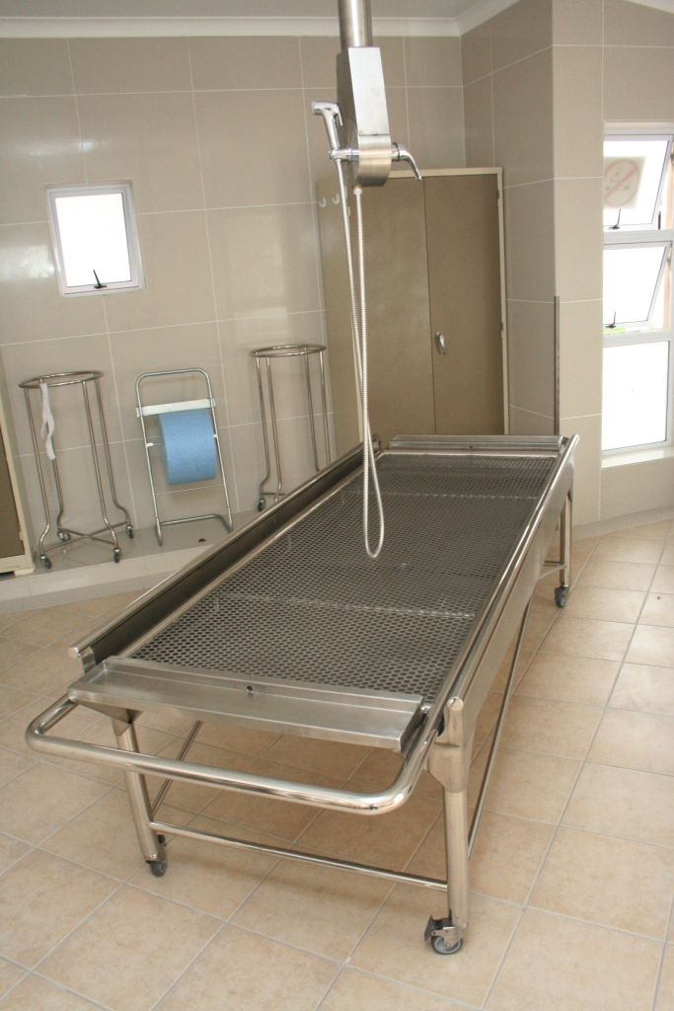
In preparation of Ghusl (bathing):
Be wearing rubber/disposable gloves
Help place the body on the table for washing
Help position the body if possible towards the Qibla or either of the following two positions:
Having the legs facing Qibla
Having the right shoulder and side towards Qibla
Make sure all equipment is ready and water is warm

Slide 21
Washing the Body...
The following duaa’ should be recited whilst the body is being washed:
Allaahummagh firlahu
“O Allah forgive him”

Slide 22
Washing the Body...
Cover body with dark material from the navel to the knees
Cut away any clothes and discard.
Remove any dentures, tubes or drips (if removing causes bleeding cover with cotton wool and tape)
Then raise the head and shoulders while the stomach is pressed to expel any waste
Now tilt the body to its left side, wipe with cotton wool and wash

Slide 23
Washing the Body...
Then wudhu should be made:
Wash the hands three times
Wash the face three times
Wash the arms to the elbows three times starting with the right arm
Masah of the head
Wash the feet up to the ankles three times starting with the right foot.
In the case of major impurity wipe the nose and mouth 3 times with wet cotton wool (then place thick pads over the openings to prevent water from entering)

Slide 24
Washing the Body...
Wash the hair. It is advisable to wash the neck at this time to avoid moving the body too much
Soap the front of the body and wash it
Tilt the body to its left, soap and wash the right side of the back, then tilt to the right and wash the left
If there are any cotton pads with tape remove them and wash the area then re-dress with fresh pads
The whole body should then be rinsed an odd number of times. 3, 5 or 7. The last wash should have dissolved camphor

Slide 25
Washing the Body...
The body should then be dried using 2 towels.
Once the front side of the body has been dried tilt the body to the left side and tuck the towel in as far under as possible. The body is then tilted to the right side and the towel drawn through. This towel is removed once the body has been placed in the shroud

Slide 26
Washing the Body...
Those present should now help lift the body on to the table with the ready, laid shroud.
Ensure one person is holding the head and another the feet.
The body is now ready for shrouding

Slide 27
The Kafn (shroud)
It is important that the shroud is bought from the wealth of the deceased
It should be clean and large enough to shroud the entire body
Preferably white in colour
The shroud should be scented with non alcoholic perfume

Slide 28
The Kafn (shroud)
The Male shroud
Material 60” wide (5ft) Length Width
Lifafah - Outer sheet 8ft 5ft
Izar - Loin cloth 7ft 5ft
Qamis/Kurta - Shirt 5ft 4/5ft
3 strips of material from the shroud for keeping shroud in place

Slide 29
The Kafn (shroud)
Woman’s shroud
Material 60” wide (5ft) Length Width
Lifafah - Outer sheet 8ft 5ft
Sina’band - Chest wrap 7ft 5ft
Izar - Loin cloth 7ft 5ft
Qamis/Kurta - Shirt 5ft 4/5ft
Orhni - Scarf 4ft 2ft
3 strips of material from the shroud for keeping shroud in place

Slide 30
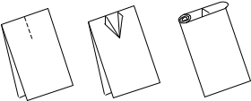
How to cut and fold the Qamis

Slide 31
Layering the Kafn
First place the lifafah (outer sheet)
Then the sina band (chest wrap)
Then the izar (trouser)
Fnally the qamis (shirt)
Leave the scarf to the side
There are several ways of layering the kafn and differences will be prevalent

Slide 32
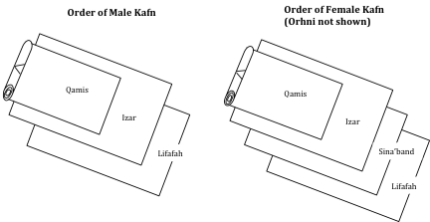
Layering the Kafn

Slide 33
Shrouding
Place the body on to the ready laid shroud
Roll the front of the Qamis over the head and body to cover until the calves.
Remove the sheet that was covering the body
Rub camphor over the sajdah (prostration) parts - the forehead, nose, palms, knees and forefeet
Fold the Izar (loin cloth) over from left to right
Fold the Lifafah, again in the same manner
Finally fasten the ends of the Lifafah at the head , the middle and below the feet.

Slide 34
Prohibitions in the Kafn
To place Quranic verses or duaa in the shroud
To place religious artefacts in the shroud
To write Kalimah etc on the shroud or on any part of the deceased

Slide 35
What to do after the shrouding
The Janazah (burial) should be arranged without delay
The Prophet (peace be upon him) said:
“If a person passes away, hasten him to his grave and do not keep him away.”
If the body is to be taken to the house only Mahram should be allowed to see the body
The Quran may be recited next to the deceased.
Those who have participated in washing the body should perform ghusl if possible

Slide 36
Q & A

Slide 37
How to Arrange a Muslim Funeral

Slide 38
Following Death
If the death is not referred to the Coroner you will need to obtain a Medical Certificate of Cause of Death (MCCD) which shows the cause of death
This is issued by a doctor (normally the one who treated the deceased)
The MCCD will be in a special sealed envelope addressed to the Registrar for Births and Deaths.
A Formal Notice will also be given by the Doctor. This states that the Doctor has signed the MCCD

Slide 39
Notification by the Coroner
Notifications by the Coroner
form “P101” (Coroners Order for Burial) is issued by the Coroner following a post mortem
form “P100 B” sent directly to the Registrars following a post mortem where death was by natural causes is established

Slide 40
Coroners Order for Burial (Form 101)

Slide 41
Non Viable Foetus and Stillbirth
Non-viable foetus - a child born prior to the 24th week of pregnancy
Stillborn - a child born after the 24th week of pregnancy
For non-viable foetus a three-part form will be issued by the hospital.
Registration will not be necessary & burial can take place immediately.
For stillborn a “Certificate of Still Birth” will be issued by the attending Doctor or Midwife
Registration for stillborn will be required prior to burial

Slide 42
How to Register a Death
Register the death with the Registrar for Births and Deaths to obtain a “Certificate for Burial”, or “Green Form”. This can be done by...
Booking an appointment with the Registrar (in the jurisdiction where the death occurred)
For Leicester call LCC on 0116 252 7000 (Bowling Green St or on Saturdays / Sundays - Town Hall)
For County call 0116 305 6565 or 3509 (County Hall)
Take with you the deceased’s MCCD together with a passport, benefit documents, medical card etc
For out of hours access (Sunday’s & bank holidays) contact MBCOL on 07803 240 493

Slide 43
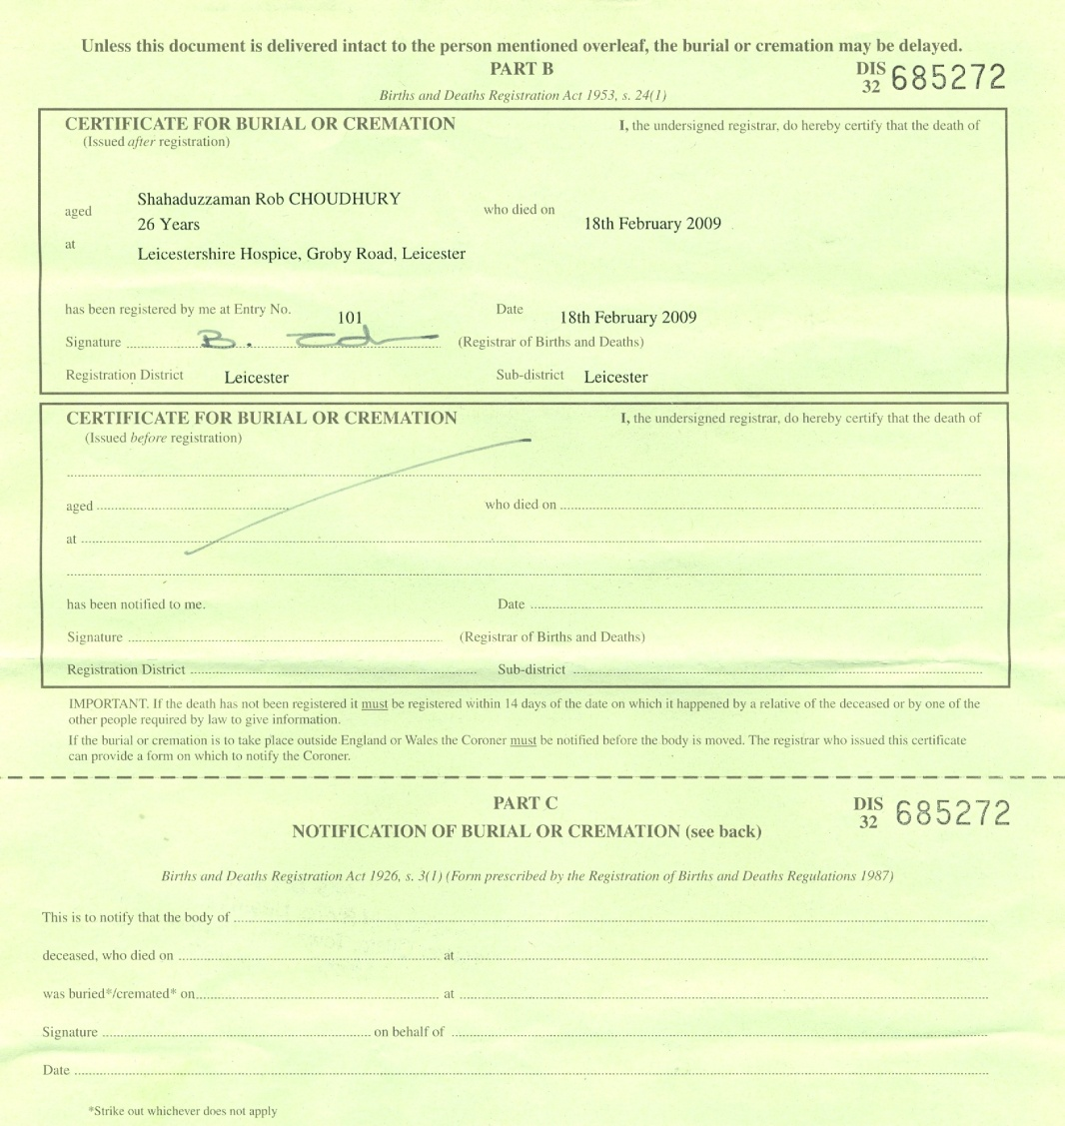
Certificate for Burial or Cremation

Slide 44
Booking an Out of Hours Burial
An out of hours burial is one that takes place after 2:30pm Monday to Friday, weekends & bank holidays
Contact your local Funeral Arranger once you have the all necessary paperwork. He will make an appointment with the MBCOL Funeral Coordinator.
Documentation will be completed and instruction will be given to the staff at Saffron Hill Cemetery to prepare the grave

Slide 45
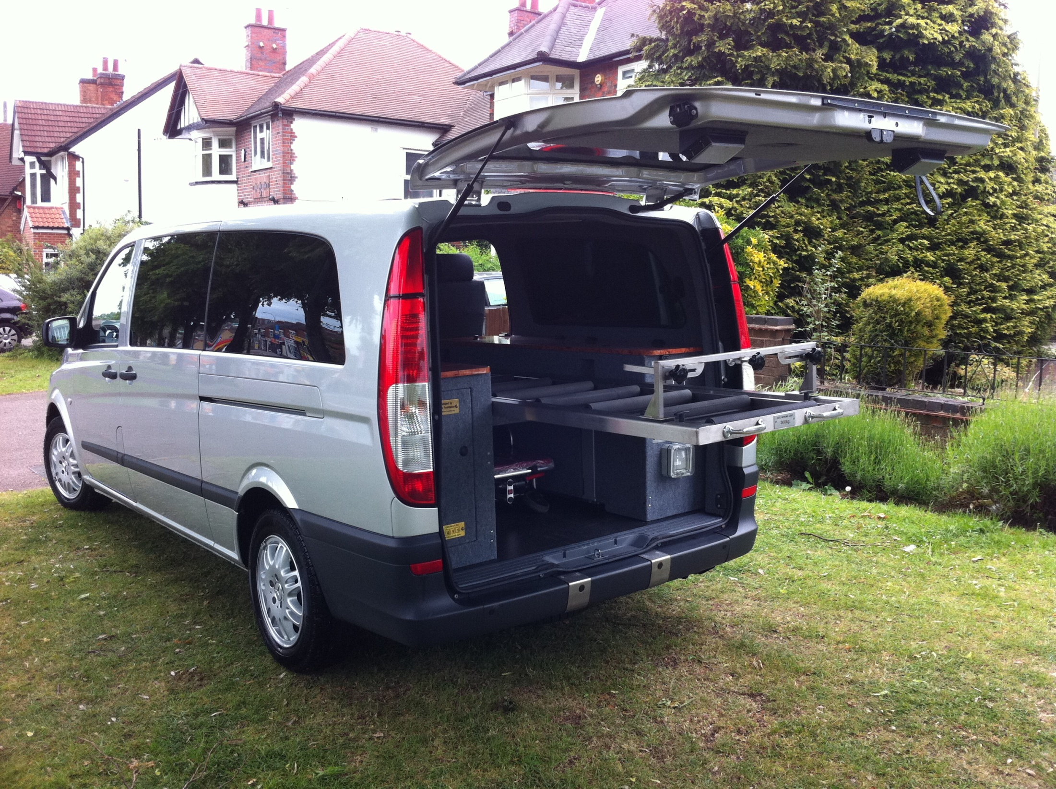
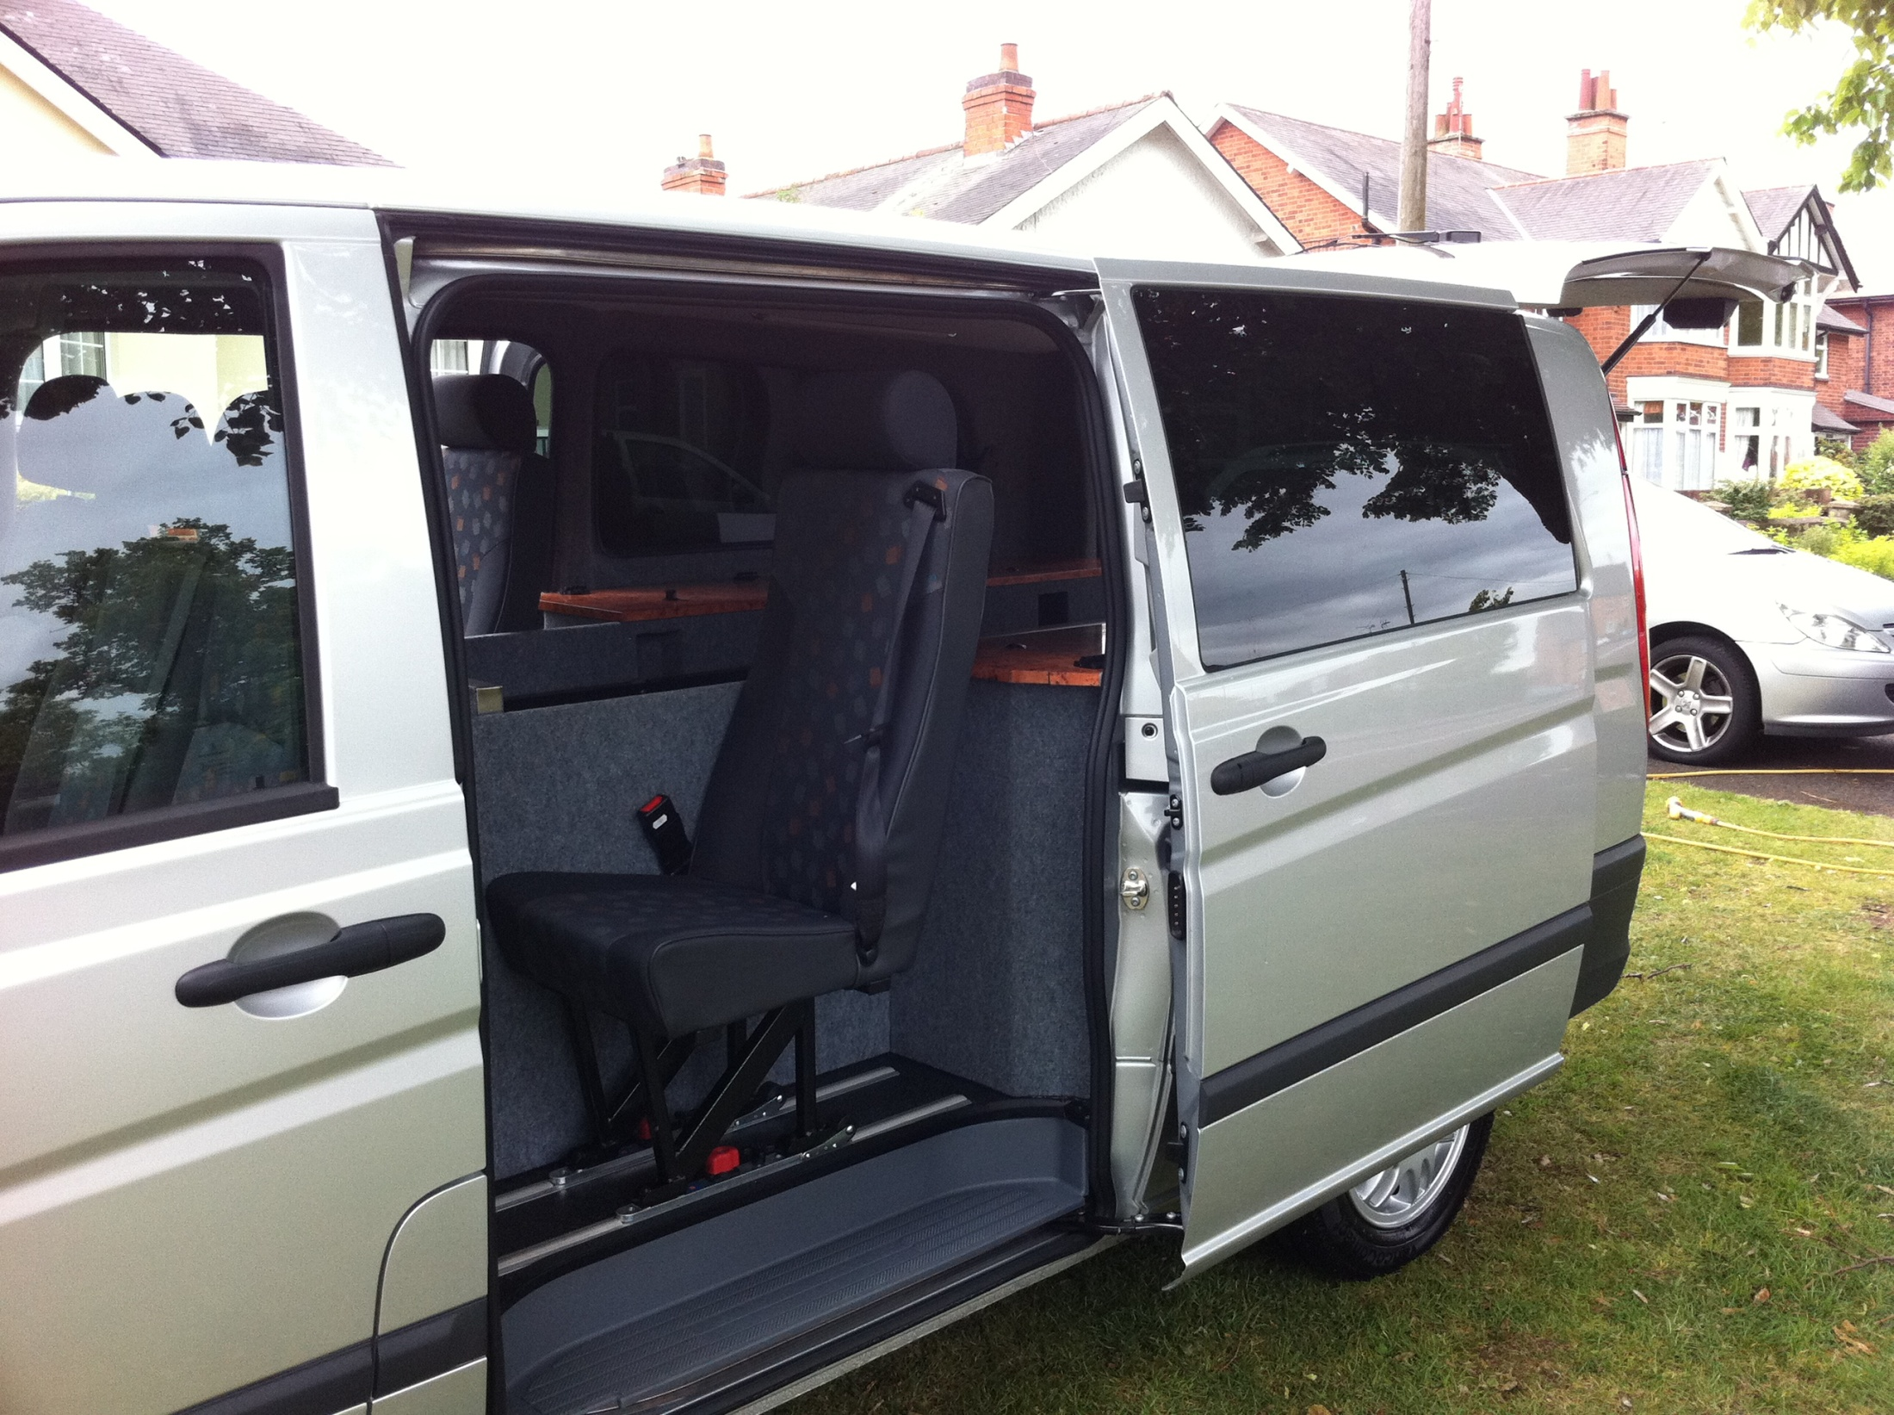
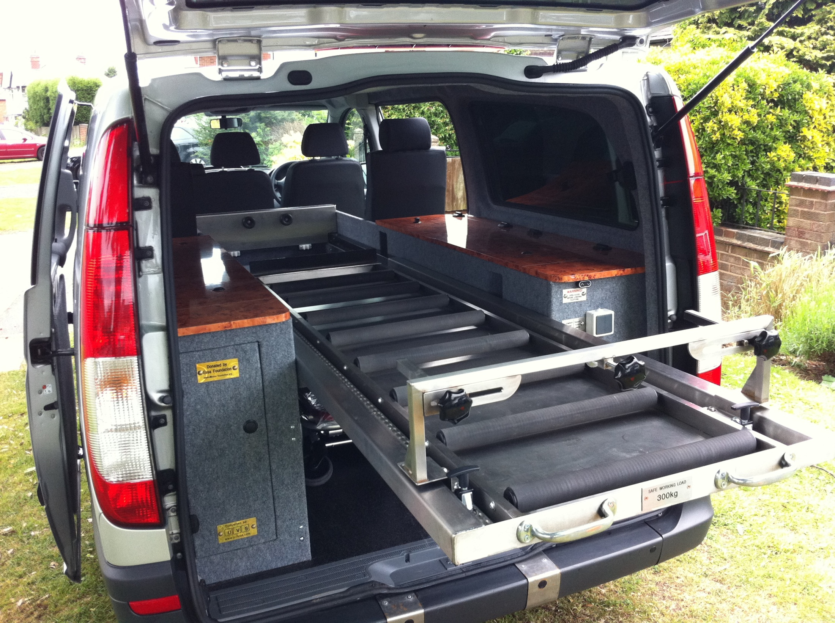
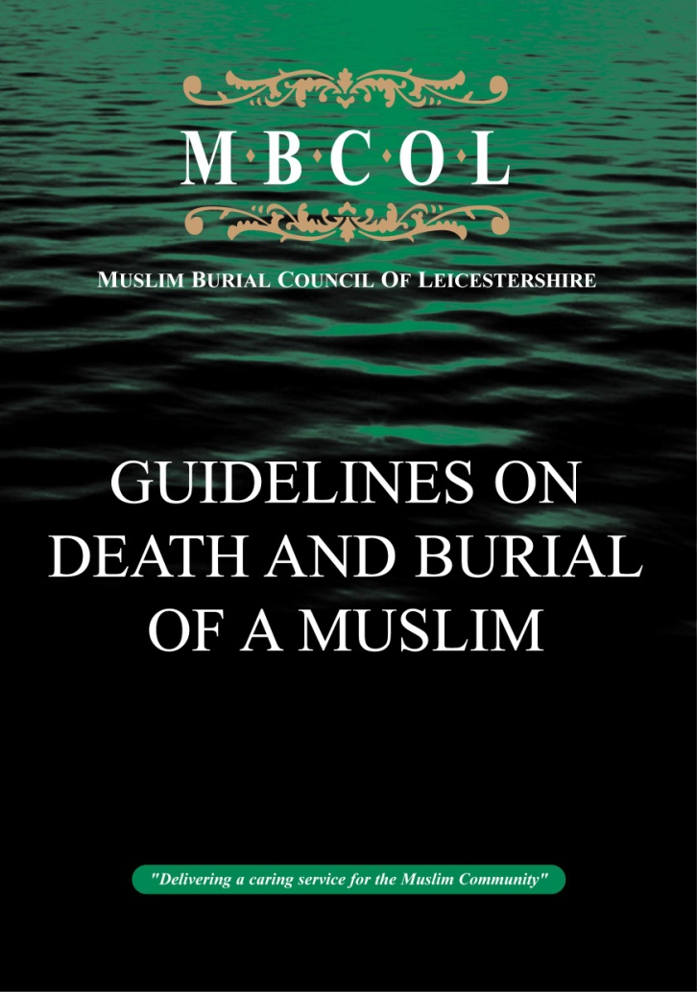
Additional Services
Use of MBCOL Funeral Vehicle
Burial without a coffin
Training
Mediation
Counselling
Awareness programmes
Publications
Research
Resources
Sign posting
Will’s and probate

Slide 46
Be Aware!
The funeral MUST take place at the appointed time. Delays may result in this service being withdrawn.
Funeral times must be agreed with the Cemeteries Department and or MBCOL before announcements are made
During the winter months funeral’s should be completed 30 minutes before sunset and during the peak summer months by 7.30pm
Settle up – Always settle service charges and bills promptly as defaulting may lead to refusal of service or a payment in advance system for future service users
Infection Control - Always take adequate safety measures

Slide 47
Q & A

Slide 48
Thank You
www.mbcol.org.uk
www.owma.org.uk
www.muslimschooloadby.co.uk

